Slide 1
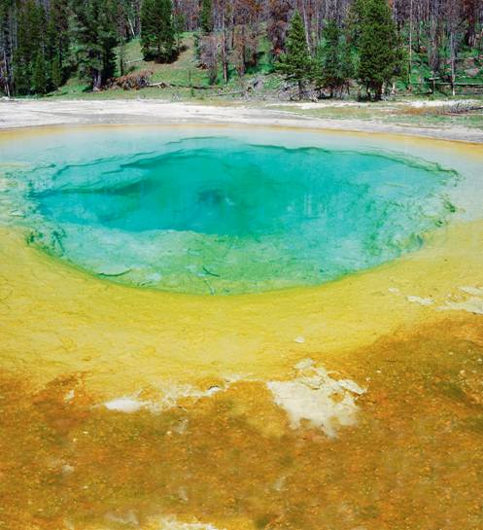
Bacteria
Notes:
Photo Credit: Michael T. Sedam/CORBIS

Slide 2
The smallest and most common microorganisms are prokaryotes—unicellular organisms that lack a nucleus.

Slide 3
Classifying Prokaryotes
All prokaryotes were once placed in the Kingdom Monera.
Recently, biologists divided them into two different kingdoms: the Eubacteria and the Archaebacteria.

Slide 4
Eubacteria
Eubacteria have a cell wall that protects the cell and determines its shape.
The cell wall of eubacteria contain peptidoglycan.
Eubacteria have a cell membrane that surrounds the cytoplasm.
Some eubacteria have a second membrane that provides added protection.

Slide 5
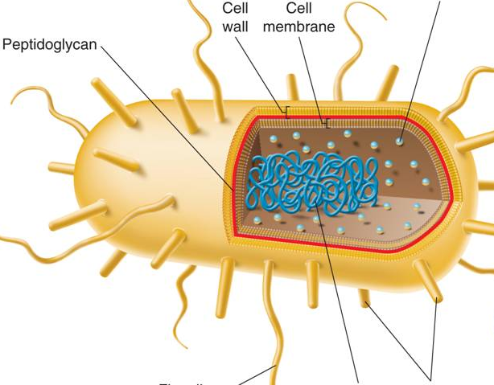
E. coli, a Typical Eubacterium
Ribosomes
Cell Wall
Cell Membrane
Peptidoglycan
Flagellum
DNA
Pili
Notes:
A bacterium such as E. coli has the basic structure typical of most prokaryotes: cell wall, cell membrane, and cytoplasm. Some prokaryotes have flagella that they use for movement. The pili are involved in cell-to-cell contact. The cell walls of eubacteria contain peptidoglycan.

Slide 6
Eubacteria include organisms that live in a variety of environments, including:
in fresh and salt water
on land
in the human body

Slide 7
Archaebacteria
The cells walls of archaebacteria do not contain peptidoglycan.
Archaebacteria have different membrane lipids.
In addition, the DNA sequences of key archaebacterial genes are more like those of eukaryotes than those of eubacteria. = eukaryote ancestor?

Slide 8
Many archaebacteria live in extreme environments.
Methanogens live in oxygen-free environments, such as thick mud and animal digestive tracts.
Other archaebacteria live in salty environments or in hot springs where water temperatures approach the boiling point.

Slide 9
Prokaryotes are identified by characteristics such as:
shape
the chemical nature of their cell walls
the way they move
the way they obtain energy

Slide 10
Shapes
Rod-shaped prokaryotes are called bacilli.
Bacilli
Notes:
Prokaryotes can be identified by their shapes. Photo Credit: ©David Scharf/Peter Arnold, Inc.

Slide 11
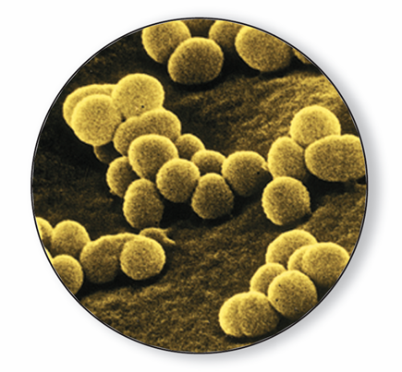
Spherical prokaryotes are called cocci.
Cocci
Notes:
Prokaryotes can be identified by their shapes. Photo Credit: ©David M. Phillips/Visuals Unlimited

Slide 12
Spiral and corkscrew-shaped prokaryotes are called spirilla.
Spirilla
Notes:
Prokaryotes can be identified by their shapes. Photo Credit: ©Scott Camazine/Photo Researchers, Inc.

Slide 13
Cell Walls
Two different types of cell walls are found in eubacteria. A method called gram staining tells them apart.
Gram-positive bacteria have thick cell walls with large amounts of peptidoglycan.
Gram-negative bacteria have thinner cell walls inside an outer lipid layer.

Slide 14
Cell Walls
Gram stain =
Violet for gram-positive bacteria
Pink for gram-negative bacteria

Slide 15
Movement
Prokaryotes can be identified by whether they move and how they move.

Slide 16
Metabolic Diversity
Prokaryotes are divided into two main groups:
Heterotrophs get their energy by consuming organic molecules made by other organisms.
Autotrophs make their own food from inorganic molecules.

Slide 17
Heterotrophs
Prokaryotes that take in organic molecules for both energy and a supply of carbon are called chemoheterotrophs.
Prokaryotes that use sunlight for energy, but take in organic compounds as a carbon source are called photoheterotrophs.

Slide 18
Autotrophs
Photoautotrophs use light energy to convert carbon dioxide and water to carbon compounds and oxygen.
Chemoautotrophs use the energy from chemical reactions to make organic carbon molecules from carbon dioxide.

Slide 19
Releasing Energy
Bacteria need a constant supply of energy, which is released by the processes of cellular respiration or fermentation or both.

Slide 20
Obligate aerobes require a constant supply of oxygen.
Bacteria that live without oxygen because they may be killed by it are called obligate anaerobes.
Bacteria that can survive with or without oxygen are known as facultative anaerobes.

Slide 21
Growth and Reproduction
Most prokaryotes reproduce by binary fission.
Some prokaryotes take part in conjugation.
Other prokaryotes produce spores.

Slide 22
Binary Fission
Binary fission is a type of asexual reproduction in which an organism replicates its DNA and divides in half, producing two identical daughter cells.

Slide 23
Binary Fission
Notes:
Most prokaryotes reproduce by binary fission, producing two identical “daughter” cells. Photo Credit: ©Dr. Dennis Kunkel/Phototake

Slide 24
Conjugation
During conjugation, a hollow bridge forms between two bacterial cells, and genes move from one cell to the other.
This transfer of genetic information increases genetic diversity in populations of bacteria.

Slide 25
Conjugation
Notes:
Some prokaryotes take part in conjugation, in which genetic information is transferred from one cell to another by way of a hollow bridge. Photo Credit: ©Dr.Dennis Kunkel/Phototake

Slide 26
In unfavorable conditions, many bacteria form spores.
An endospore forms when a bacterium produces a thick internal wall that encloses its DNA and some of its cytoplasm.
Spores can remain dormant for months or years, allowing bacteria to survive harsh conditions.

Slide 27
Spore Formation
Notes:
Some prokaryotes produce endospores, which allow them to withstand harsh conditions. Credit: ©A. B. Dowsett/Science Photo Library/Photo Researchers, Inc.

Slide 28
Bacteria are vital to the living world. They are:
Producers that perform photosynthesis.
Decomposers that break down dead matter.
Nitrogen fixers
And more!

Slide 29
Decomposers
Bacteria recycle nutrients and maintain equilibrium in the environment.
Bacteria also help in the treatment of sewage.

Slide 30
Nitrogen Fixers
Plants need nitrogen gas to be changed chemically to ammonia or other nitrogen compounds, which certain bacteria produce.
The process of converting nitrogen gas into a form plants can use is known as nitrogen fixation.
Many plants have symbiotic relationships with nitrogen-fixing bacteria.

Slide 31
We depend on bacteria for many things, including:
foods and beverages
removal of waste and poisons from water
mining minerals from the ground
synthesis of drugs and chemicals via genetic engineering
production of vitamins in human intestines

Slide 32
Viruses

Slide 33
What Is a Virus?
Viruses are particles of nucleic acid, protein, and in some cases, lipids.
Viruses can reproduce only by infecting living cells.

Slide 34
Viruses differ widely in terms of size and structure.
All viruses enter living cells and use the infected cell to produce more viruses.

Slide 35
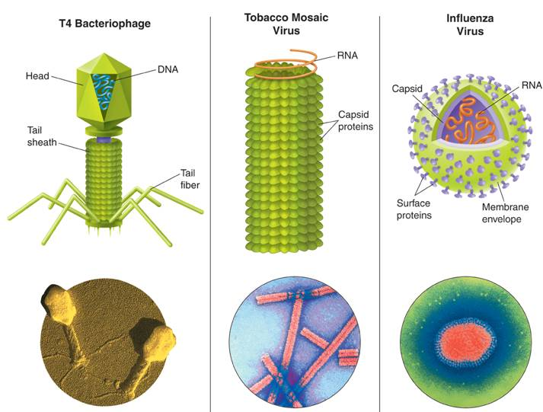
T4 Bacteriophage
Tobacco Mosaic Virus
Influenza Virus
RNA
Head
DNA
RNA
Capsid
Tail sheath
Tail fiber
Membrane envelope
Surface proteins
Capsid proteins
Notes:
Viruses come in a wide variety of sizes and shapes. A typical virus is composed of a core of either DNA or RNA, which is surrounded by a protein coat, or capsid.
Photo Credits: l. ©M.Wurtz/Biozentrum, University of Basel/Science Photo Library/Photo Researchers, Inc. m. ©Dr. O. Bradfute/Peter Arnold, Inc. r. ©National Institute for Biological Standards and
Control, England/Photo Researchers, Inc.

Slide 36

A typical virus is composed of a core of DNA or RNA surrounded by a protein coat, called a capsid

Slide 37
Capsid proteins bind to receptors on the cell surface and “trick” the cell into allowing it inside.
Once inside, viral genes are expressed and the cell transcribes and translates them into viral capsid proteins.
The host cell may makes copies of the virus, and be destroyed.

Slide 38
Most viruses are highly specific to the cells they infect.
Viruses that infect bacteria are called bacteriophages.

Slide 39
Viral Infection
Once the virus is inside the host cell, two different processes may occur.
Some viruses replicate immediately, killing the host cell.
Others replicate, but do not kill the host cell immediately.

Slide 40
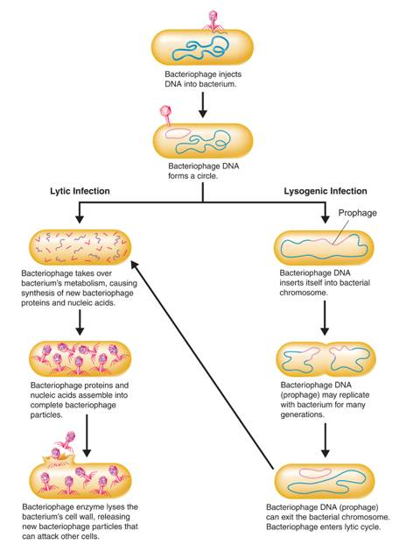
Bacteriophage injects DNA into bacterium
Bacteriophage DNA forms a circle
Lytic Infection
Lysogenic Infection
Notes:
Bacteriophage may infect cells in two ways: lytic infection and lysogenic infection.

Slide 41
Lytic Infection
In a lytic infection, a virus enters a cell, makes copies of itself, and causes the cell to burst.

Slide 42
First, the bacteriophage injects DNA into a bacterium.
The bacteriophage DNA forms a circle.

Slide 43
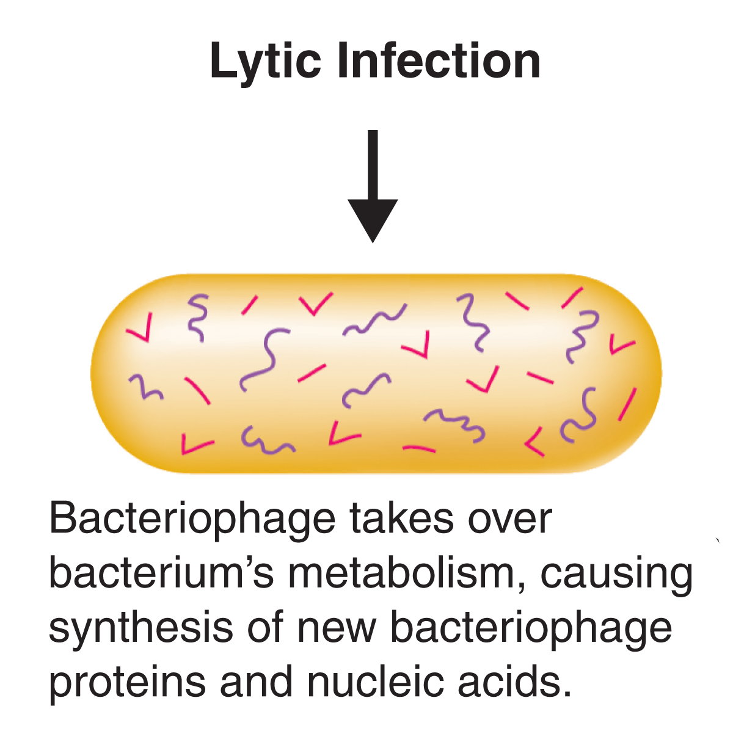
Notes:
Bacteriophage may infect cells in two ways: lytic infection and lysogenic infection.

Slide 44
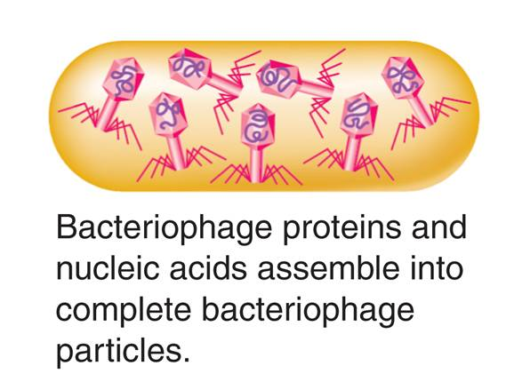
Notes:
Bacteriophage may infect cells in two ways: lytic infection and lysogenic infection.

Slide 45
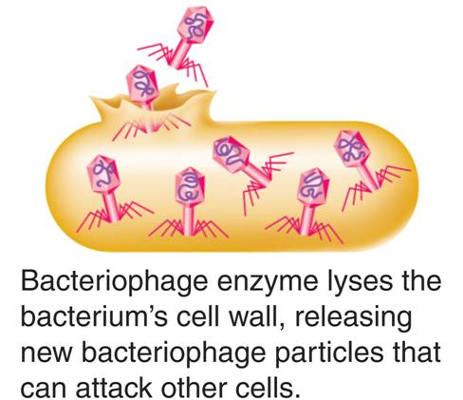
Notes:
Bacteriophage may infect cells in two ways: lytic infection and lysogenic infection.

Slide 46
Lysogenic Infection
Other viruses cause lysogenic infections in which a host cell makes copies of the virus indefinitely.
In a lysogenic infection, a virus integrates its DNA into the DNA of the host cell, and the viral genetic information replicates along with the host cell's DNA.

Slide 47
A lysogenic infection begins the same way as a lytic infection.
The bacteriophage injects DNA into a bacterium.
The bacteriophage DNA forms a circle.
The viral DNA embedded in the host's DNA is called a prophage.

Slide 48
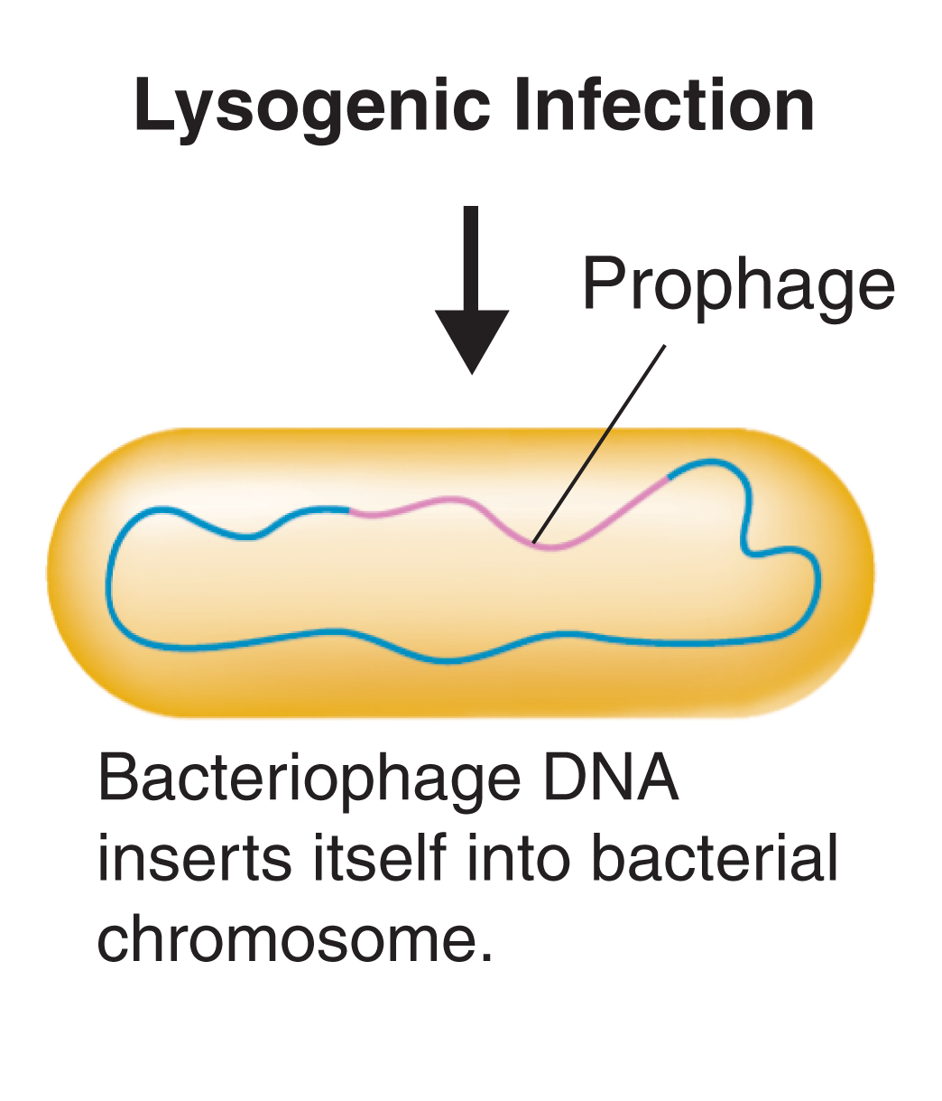
Notes:
Bacteriophage may infect cells in two ways: lytic infection and lysogenic infection.

Slide 49
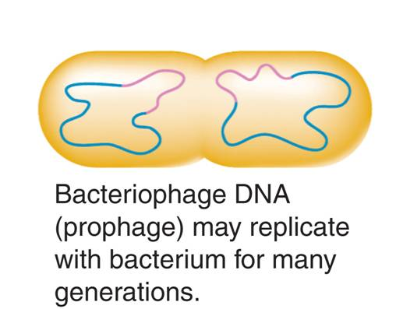
Notes:
Bacteriophage may infect cells in two ways: lytic infection and lysogenic infection.

Slide 50
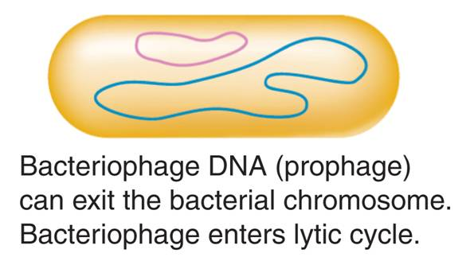
Notes:
Bacteriophage may infect cells in two ways: lytic infection and lysogenic infection.

Slide 51
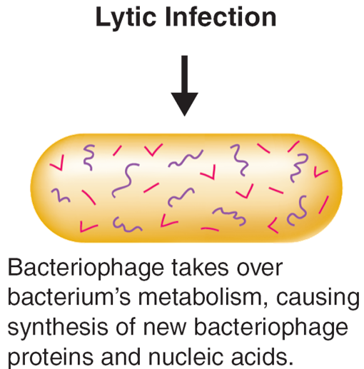
Notes:
Bacteriophage may infect cells in two ways: lytic infection and lysogenic infection.

Slide 52
Retroviruses
Retroviruses contain RNA as their genetic information.
When retroviruses infect cells, they make a DNA copy of their RNA.
This DNA is inserted into the DNA of the host cell.

Slide 53
A retrovirus’ genetic information is copied backward—from RNA to DNA.
The virus that causes AIDS is a retrovirus.

Slide 54
Viruses and Living Cells
Viruses must infect a living cell in order to grow and reproduce.
They take advantage of the host’s respiration, nutrition, and all other functions of living things.

Slide 55
Viruses have many of the characteristics of living things.
After infecting living cells, viruses can reproduce, regulate gene expression, and even evolve.

Slide 56
Because viruses are dependent on living things, it seems likely that viruses developed after living cells.
The first viruses may have evolved from genetic material of living cells.
Viruses have continued to evolve over billions of years.

Slide 57
Diseases Caused by Bacteria and Viruses
Notes:
Photo Credit: ©National Institute for Biological Standards and Control, England/Photo Researchers, Inc.

Slide 58
Bacteria and viruses are everywhere in nature, but only a few cause disease.
French chemist Louis Pasteur helped establish that bacteria can cause disease.
Disease-causing agents are called pathogens.

Slide 59
Bacterial Disease in Humans
Growth of pathogenic bacteria disrupts the body’s equilibrium by interfering with its normal activities and producing disease.

Slide 60
Bacteria produce disease in one of two general ways.
Some bacteria damage the cells and tissues of the infected organism directly by breaking down the cells for food.
Other bacteria release toxins (poisons) that travel throughout the body interfering with the normal activity of the host.

Slide 61
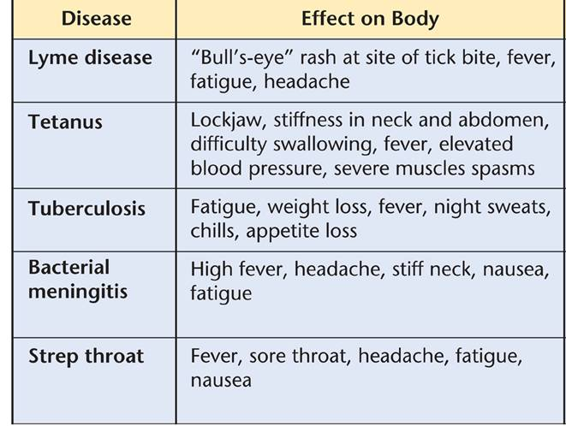
Bacterial Diseases
Notes:
Bacteria cause disease in the body. Some of the diseases caused by pathogenic bacteria are listed in the table.

Slide 62
Many bacterial diseases can be prevented by vaccines.
A vaccine is a preparation of weakened or killed pathogens.
When injected into the body, a vaccine may prompt the body’s immunity to the disease.
Immunity is the body's ability to destroy new pathogens.

Slide 63
If infection occurs, drugs can be used to destroy bacteria.
Antibiotics are compounds that block the growth and reproduction of bacteria.
A reason for increased human life expectancy is an increased understanding of how to prevent and cure bacterial infections.
Proper hand washing with ordinary soap removes most bacteria.

Slide 64
There are various methods used to control bacterial growth, including:
sterilization
disinfectants
food processing

Slide 65
Sterilization by Heat
Sterilization destroys bacteria by subjecting them to great heat.
Most bacteria are killed by prolonged high temperatures.

Slide 66
Disinfectants
Disinfectants are chemical solutions that kill pathogenic bacteria.
They are used to clean rooms where bacteria may flourish.

Slide 67
Food Storage and Processing
Bacteria can cause food to spoil.
Refrigerated food stays fresh longer because the bacteria will take longer to multiply.
Boiling, frying, or steaming can sterilize certain foods.

Slide 68
Viruses produce disease by disrupting the body's normal equilibrium.

Slide 69
Viruses can attack and destroy certain cells in the body, causing symptoms of the disease.
Other viruses cause infected cells to change patterns of growth and development.

Slide 70
Viral diseases cannot be treated with antibiotics.
Vaccines are often the best protection against most diseases.
Most vaccines work only if used before an infection begins.
Symptoms may be treated with over-the-counter medicines.

Slide 71
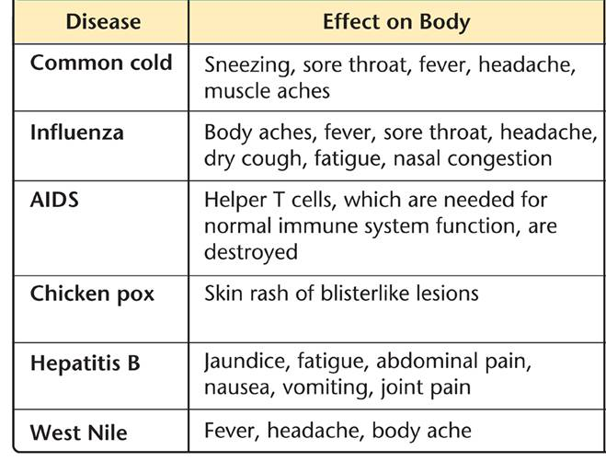
Viral Diseases
Notes:
Viruses cause disease in the body. Some of the diseases caused by viruses are listed in the table.

Slide 72
Viral Disease in Plants and Animals
Viruses produce serious animal diseases including foot-and-mouth disease.
Many viruses infect plants.
These viruses pose a serious threat to many crops.

Slide 73
Viroids and Prions
Other viruslike particles that can cause disease are viroids and prions.
Viroids cause disease in plants.
Prions cause disease in animals.

Slide 74
Viroids
Viroids are single-stranded RNA molecules that have no surrounding capsids.
Viroids enter an infected cell and synthesize new viroids.
They then disrupt the cell’s metabolism and stunt the growth of the entire plant.

Slide 75
Prions
Prions contain only protein—no DNA or RNA.
Prions cause disease by forming protein clumps. These clumps induce normal protein molecules to become prions.
Eventually, there are so many prions in the nerve tissue that cells become damaged.
Mad cow disease may be caused by prions.

Slide 76
http://www.youtube.com/watch?v=L8oHs7G_syI&feature=plcp

Slide 77
Viruses and Human Health
Destruction of host cell by viral replication causes symptoms
Infections are difficult to treat and Antibiotics DON’T WORK on viruses, only microorganisms

Slide 78
Vaccines- Liquid preparations of dead or weakened viral or bacterial cells that stimulate the body’s immune system to fight back
Some viral and bacterial diseases can be PREVENTED with vaccines (oral or injection)

Slide 79
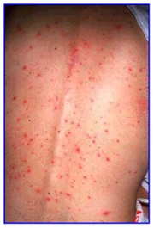
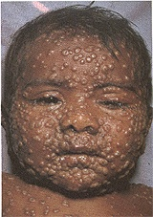
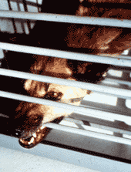
Symptoms

Slide 80
Emerging Viruses
HIV
Hantavirus
http://www.cdc.gov/ncidod/diseases/hanta/hps/
Ebola
http://www.cdc.gov/ncidod/dvrd/spb/mnpages/dispages/ebola.htm
Avian Influenza Virus
CDC
Government of Canada

Slide 81
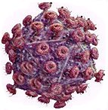
AIDS: Some Facts
AIDS is caused by a virus → HIV, the Human Immunodeficiency Virus
If you get infected with HIV, your body will try to fight the infection by making "antibodies“
When you get a blood test for HIV, the test looks for these antibodies → If you have them in your blood, it means that you have HIV infection and are "HIV-Positive“
HIV is transferred through blood, vaginal fluid, semen and breast milk

Slide 82
AIDS: Some Facts
AIDS is currently responsible for five percent of all deaths worldwide, between 2.5 to 3.5 million in 2003
Each year there are 5,300,000 new infections
Africa carries a disproportionate share of this burden, as do women; and in some African countries life-expectancy has been reduced to as low as 32.7 years
AIDS is as much a health issue as it is a social, political, and economic issue

Slide 83
Homework
http://www.pbs.org/wgbh/nova/body/1918-flu.html

Slide 84
Chapter 19- Viruses and Bacteria Multiple Choice Practice Questions

Slide 85

19–1
Which characteristic distinguishes eubacteria from archaebacteria?
Eubacteria lack peptidoglycan in their cell walls.
Eubacteria contain peptidoglycan in their cell walls.
Eubacteria lack a nucleus.
Eubacteria do not possess mitochondria.

Slide 86

19–1
Which characteristic distinguishes eubacteria from archaebacteria?
Eubacteria lack peptidoglycan in their cell walls.
Eubacteria contain peptidoglycan in their cell walls.
Eubacteria lack a nucleus.
Eubacteria do not possess mitochondria.

Slide 87

19–1
Rod-shaped prokaryotes are called
bacilli.
cocci.
spirilla.
streptococci.

Slide 88
19–1
Rod-shaped prokaryotes are called
bacilli.
cocci.
spirilla.
streptococci.

Slide 89

19–1
Bacteria that must live without oxygen are called
obligate aerobes.
facultative anaerobes.
obligate anaerobes.
facultative aerobes.

Slide 90
19–1
Bacteria that must live without oxygen are called
obligate aerobes.
facultative anaerobes.
obligate anaerobes.
facultative aerobes.

Slide 91

19–1
Prokaryotes that make their own food molecules from carbon dioxide and water but live where there is no light are called
photoautotrophs.
photoheterotrophs.
chemoautotrophs.
chemoheterotrophs.

Slide 92
19–1
Prokaryotes that make their own food molecules from carbon dioxide and water but live where there is no light are called
photoautotrophs.
photoheterotrophs.
chemoautotrophs.
chemoheterotrophs.

Slide 93

19–1
Bacteria that attack and digest the tissue of dead organisms are called
decomposers.
nitrogen fixers.
chemoautotrophs.
archaebacteria.

Slide 94
19–1
Bacteria that attack and digest the tissue of dead organisms are called
decomposers.
nitrogen fixers.
chemoautotrophs.
archaebacteria.

Slide 95
19–2
Viruses that contain RNA as their genetic information are known as
prions.
oncoviruses.
retroviruses.
bacteriophage.

Slide 96
19–2
Viruses that contain RNA as their genetic information are known as
prions.
oncoviruses.
retroviruses.
bacteriophage.

Slide 97
19–2
The first type of virus to be studied was the
bacteriophage.
tobacco mosaic virus.
influenza virus.
AIDS virus.

Slide 98
19–2
The first type of virus to be studied was the
bacteriophage.
tobacco mosaic virus.
influenza virus.
AIDS virus.

Slide 99

19–2
Which of the following statements about viruses is true?
Viruses appear similar to bacteria when studied with a light microscope.
Viruses display the essential characteristics of living things.
Viruses can reproduce independently if they contain DNA.
Viruses cannot reproduce unless they infect a living cell.

Slide 100
19–2
Which of the following statements about viruses is true?
Viruses appear similar to bacteria when studied with a light microscope.
Viruses display the essential characteristics of living things.
Viruses can reproduce independently if they contain DNA.
Viruses cannot reproduce unless they infect a living cell.

Slide 101
19–2
A virus integrates its DNA into the DNA of the host cell but remains inactive for a while in
a lytic infection.
a lysogenic infection.
neither a lytic nor a lysogenic infection.
retroviral infection.

Slide 102
19–2
A virus integrates its DNA into the DNA of the host cell but remains inactive for a while in
a lytic infection.
a lysogenic infection.
neither a lytic nor a lysogenic infection.
retroviral infection.

Slide 103
19–2
Retroviruses are considered unique because
they have RNA in their capsid and not DNA.
they have DNA in their capsid and not RNA.
after infection of a host cell, their RNA makes DNA.
after infection of a host cell, their DNA makes RNA.

Slide 104
19–2
Retroviruses are considered unique because
they have RNA in their capsid and not DNA.
they have DNA in their capsid and not RNA.
after infection of a host cell, their RNA makes DNA.
after infection of a host cell, their DNA makes RNA.

Slide 105
19–3
Biologists know that bacteria can cause human disease by
entering cells and using the cell to make new bacteria.
producing toxic substances that interfere with normal cell function.
decomposing the remains of dead organisms.
changing atmospheric nitrogen into nitrogen compounds.

Slide 106
19–3
Biologists know that bacteria can cause human disease by
entering cells and using the cell to make new bacteria.
producing toxic substances that interfere with normal cell function.
decomposing the remains of dead organisms.
changing atmospheric nitrogen into nitrogen compounds.

Slide 107
19–3
A process that destroys bacteria by subjecting them to great heat is known as
refrigeration.
sterilization.
pickling.
boiling.

Slide 108
19–3
A process that destroys bacteria by subjecting them to great heat is known as
refrigeration.
sterilization.
pickling.
boiling.

Slide 109
19–3
Which of the following diseases is transmitted by a mosquito bite?
influenza
measles
West Nile virus
chickenpox

Slide 110
19–3
Which of the following diseases is transmitted by a mosquito bite?
influenza
measles
West Nile virus
chickenpox

Slide 111
19–3
Which of the following diseases is thought to be caused by prions?
diphtheria
mad cow disease
tuberculosis
smallpox

Slide 112
19–3
Which of the following diseases is thought to be caused by prions?
diphtheria
mad cow disease
tuberculosis
smallpox

Slide 113
19–3
The best way to combat viral diseases is
to use antibiotics.
to treat individual symptoms.
to use preventive vaccines.
to let the disease “cure itself.”

Slide 114
19–3
The best way to combat viral diseases is
to use antibiotics.
to treat individual symptoms.
to use preventive vaccines.
to let the disease “cure itself.”

